Slide 1


Social Buzz

Slide 2


Today's agenda
Project recap
Problem
The Analytics team
Process
Insights
Summary

Slide 3

Social Buzz is a fast growing company in social media & content creation market.
Over the past 5 years, Social Buzz has reached over 500 million active users each month. They have scaled quicker than anticipated and need the help of an advisory firm to oversee their scaling process effectively. Due to their rapid growth and digital nature of their core product, the amount of data that they create, collect and must analyze is huge.
Our Tasks at Accenture are the following:
Audit of big data best practices
Preparation of best practice document for IPO
Analysis of their content categories that highlights the top 5 categories with the largest aggregate popularity.
Project Recap

Slide 4


Problem
Users post over 100,000 pieces of content every day
With tens of millions of posts and hundreds of millions of users, how do you capitalize?

Slide 5



Marco Zazzini
Data Analyst
The Analytics team
Marcus Rompton
Senior Principal
Andrew Fleming
Chief Technology Architect

Slide 6
Process
1
Data Understanding
2
Data Cleaning
3
Data Modelling
4
Data Analysis
5
Uncover Insights

Slide 7

Insights
16
Unique Category
1897
Reactions to ‘Animal’ Posts
MAY
Month with Most posts

Slide 8
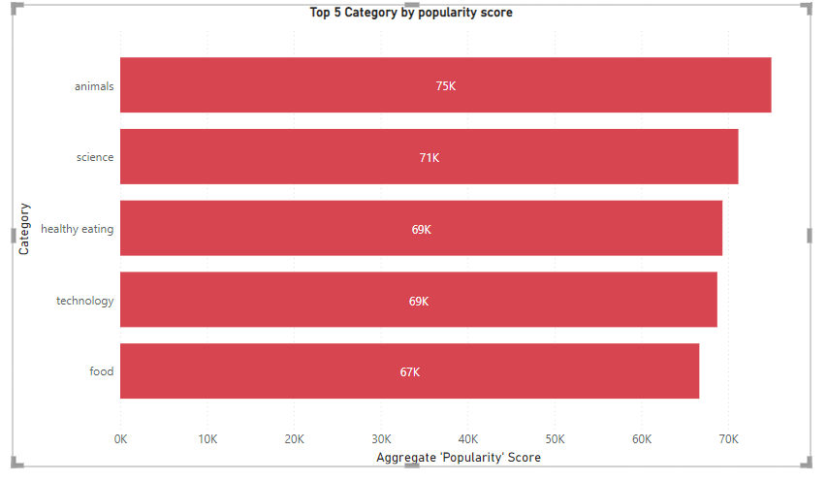

Slide 9
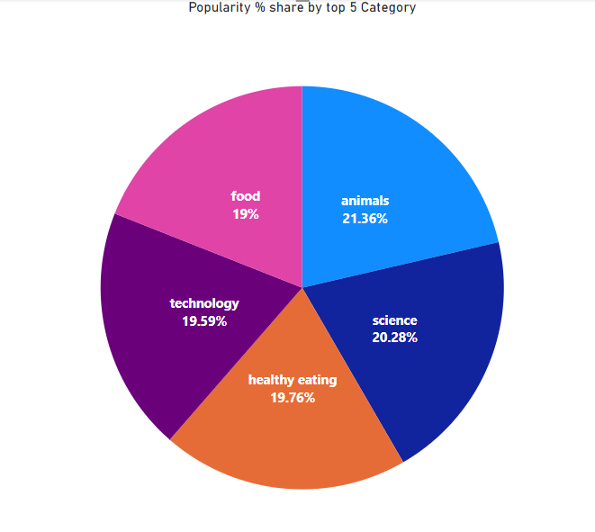

Slide 10
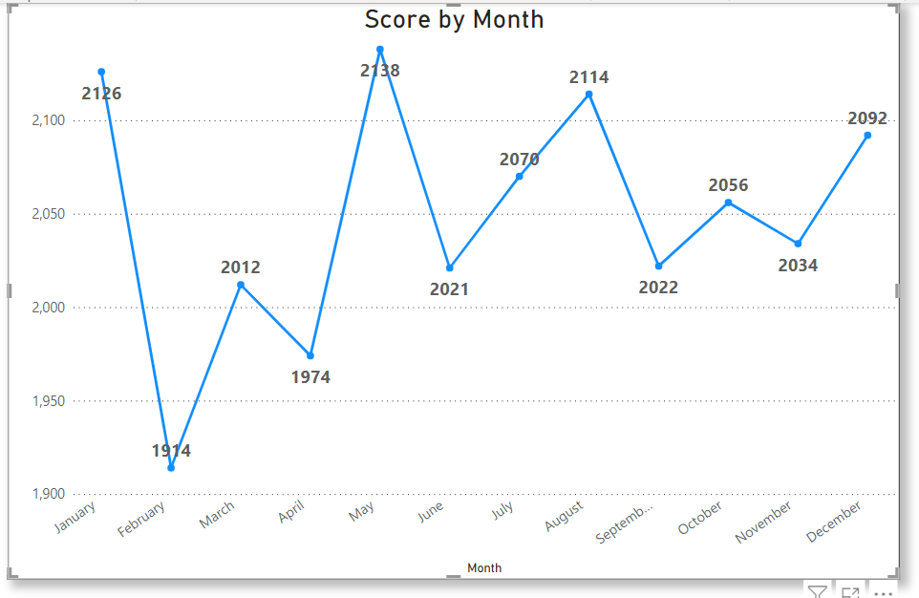

Slide 11

ANALYSIS
Animals and science are two most popular categories of content, showing that people enjoy ‘real-life’ and ‘factual’ content the most.
INSIGHT
Food is the common theme with the top 5 categories with ‘Healthy Eating’ ranking the highest. This may give an indication to the audience within your user base. You could use this insight to create a campaign and work with healthy eating brands to boost user engagement.
NEXT STEPS
This ad-hoc analysis is insightful , but it’s time to take this analysis into large scale production for real-time understanding your business.
Summary

Slide 12

Thank you!
ANY QUESTIONS?

